Slide 1
AI AND MACHINE LEARNING
Hands-on introductory course

Slide 2
CLUSTERING

Slide 3
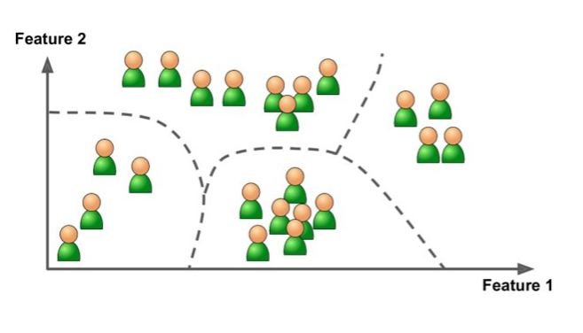
Unsupervised and supervised learning
Supervised learning
feed labelled training data (features + labels/value) to a model
using the model, predict the label/value of new data based on the features
everything in this course is supervised, except for clustering
Unsupervised learning
training data is not labelled
example: clustering (e.g. finding
similar products, ...)

Slide 4
Clustering
Notes:
“finding similar products”. In practise, recommender systems are built via techniques like collaborative filtering, this is out of scope...

